Slide 1

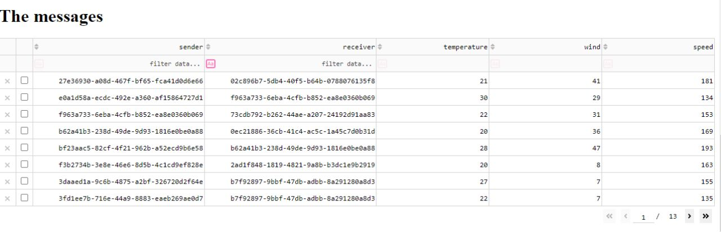
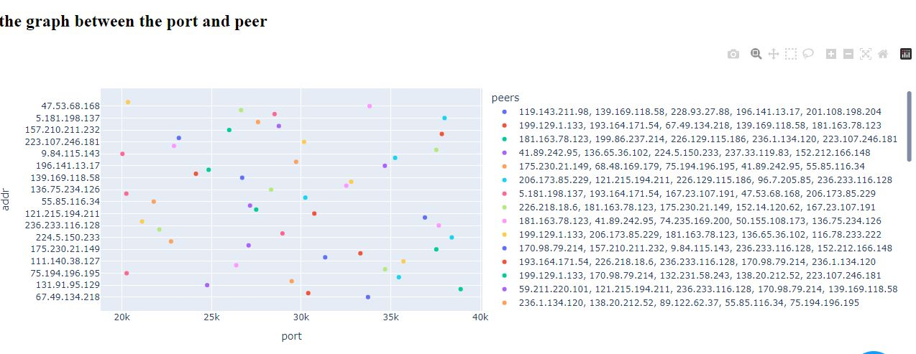
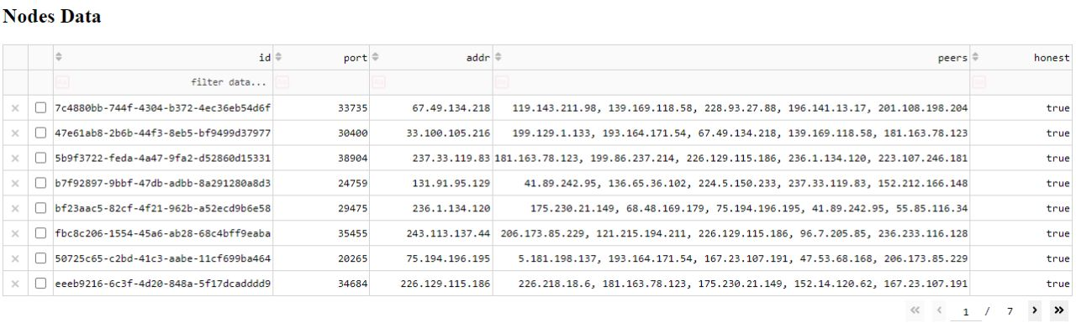
IOT CONSENSUS MECHANISM - ANALYSIS
Department of Computer Science & Engineering
School of Computing
1156CS701 – MAJOR PROJECT
WINTER SEMESTER 2022-2023
ABSTRACT
INTRODUCTION
RESULTS
STANDARDS AND POLICIES
The abstract for this project is to develop a dashboard that can visualize statistics and the network graph, gather and calculate statistics from IoT devices, and provide real-time visualization of the blockchain and consensus process. The project involves a decentralized network of Raspberry Pi running blockchain and consensus software developed by the project team. The monitoring server will collect and analyze data from the blockchain and consensus process, and the frontend system will display the data in an easy-to-understand format. The statistics collected from IoT devices will help ensure the network is functioning correctly and enable users to detect and address any issues. The overall goal is to create a comprehensive monitoring system that provides valuable insights into the health and status of the network and enables users to take appropriate action as needed.
The rise of blockchain technology has ushered in a new era of decentralization and transparency. However, monitoring the health and status of a blockchain network can be a challenge, particularly when it comes to large-scale deployments. To address this challenge, our project aims to implement a comprehensive monitoring system for a decentralized network of Raspberry Pi running blockchain software and consensus software.
The monitoring system will collect and analyze data from the blockchain and consensus process, as well as from IoT devices connected to the network. The data will be displayed in real-time using a visually appealing frontend system, providing users with valuable insights into the health and status of the network. Our project represents a significant step forward in the world of blockchain monitoring and management, providing a comprehensive and user-friendly solution for keeping tabs on blockchain networks.
A comprehensive monitoring system for a decentralized network of Raspberry Pi devices running blockchain and consensus software. The system would gather and calculate statistics from IoT devices and provide real-time visualization of the blockchain and consensus process. The monitoring server would collect and analyze data from the network and the frontend system would display the data in an easy-to-understand format.
The system would help ensure the network is functioning correctly, detect and address any issues, and provide valuable insights into the health and status of the network. It would enable users to take appropriate action as needed to maintain the network's performance and security.
Software Development Standards: The project team should follow best practices for software development, including code reviews, version control, and automated testing. They should also document their code and follow coding standards to ensure the software is maintainable and scalable.
Accessibility Standards: The frontend system should adhere to accessibility standards such as WCAG 2.0 to ensure that it is usable by people with disabilities
Network Monitoring Policy: The project team should define a policy for network monitoring that outlines the types of data that will be collected, how it will be analyzed, and who will have access to it
Output 1.The Graph between port and peers.
METHODOLOGIES
CONCLUSIONS
The first scatter plot shows the relationship between the port number and the IP address of each node, with the color of each node indicating its connections to other nodes. The second scatter plot shows the relationship between the sender and receiver of each message, with the color indicating the temperature of the message payload.
The two tables show the data for the nodes and messages, respectively. The table for nodes includes columns for the node ID, port number, IP address, connected peers, and whether the node is honest or not. The table for messages includes columns for the sender, receiver, and various attributes of the message payload, such as temperature, wind, and speed.
This project aims to develop a custom blockchain and consensus mechanism using Raspberry Pi connected in a decentralized network. To monitor the status of the blockchain and consensus process, a centralized monitoring server will be built using Grafana as the frontend, Prometheus as the backend, and a custom Python REST API for each Raspberry Pi to provide data. The implementation of this technology will enable the visualization of statistics, network graphs, and the consensus process in real time.
TEAM MEMBER DETAILS
Output 2 Node Data:
Vtu15600/Abiram G
9347793901
vtu15600@veltech.edu.in
ACKNOWLEDGEMENT
Dr. V .Dhilip kumar ,M.E .,Ph.D.,
+91 9994614463
vdhilipkumar@veltech.edu.in

